Slide 1
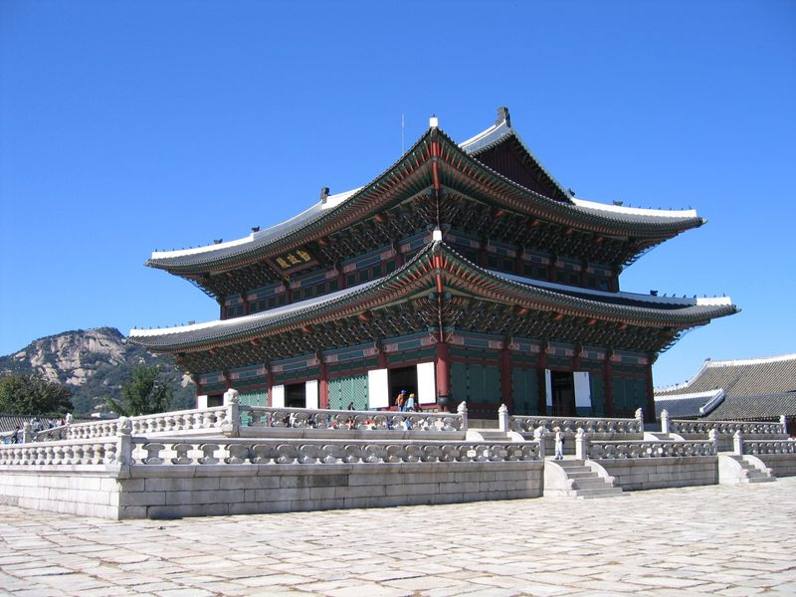
The Korean Kingdoms Earliest Times

Slide 2
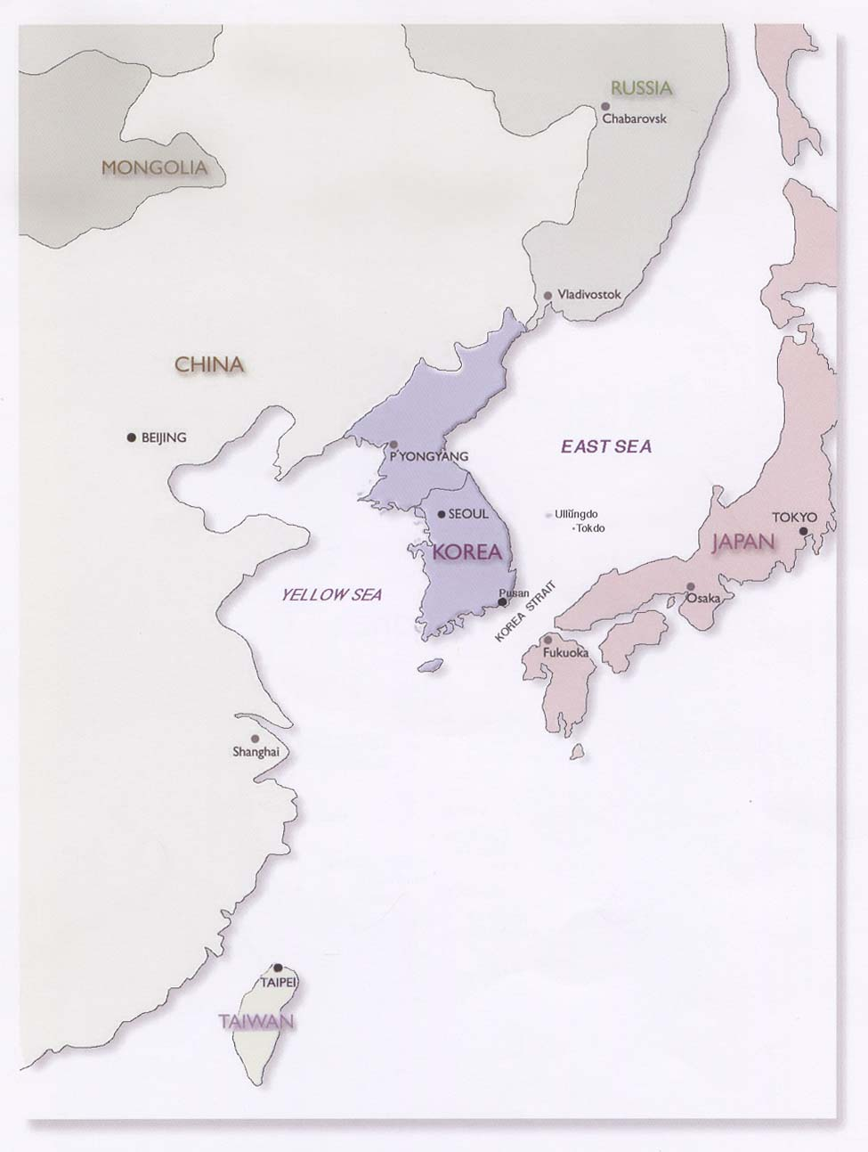
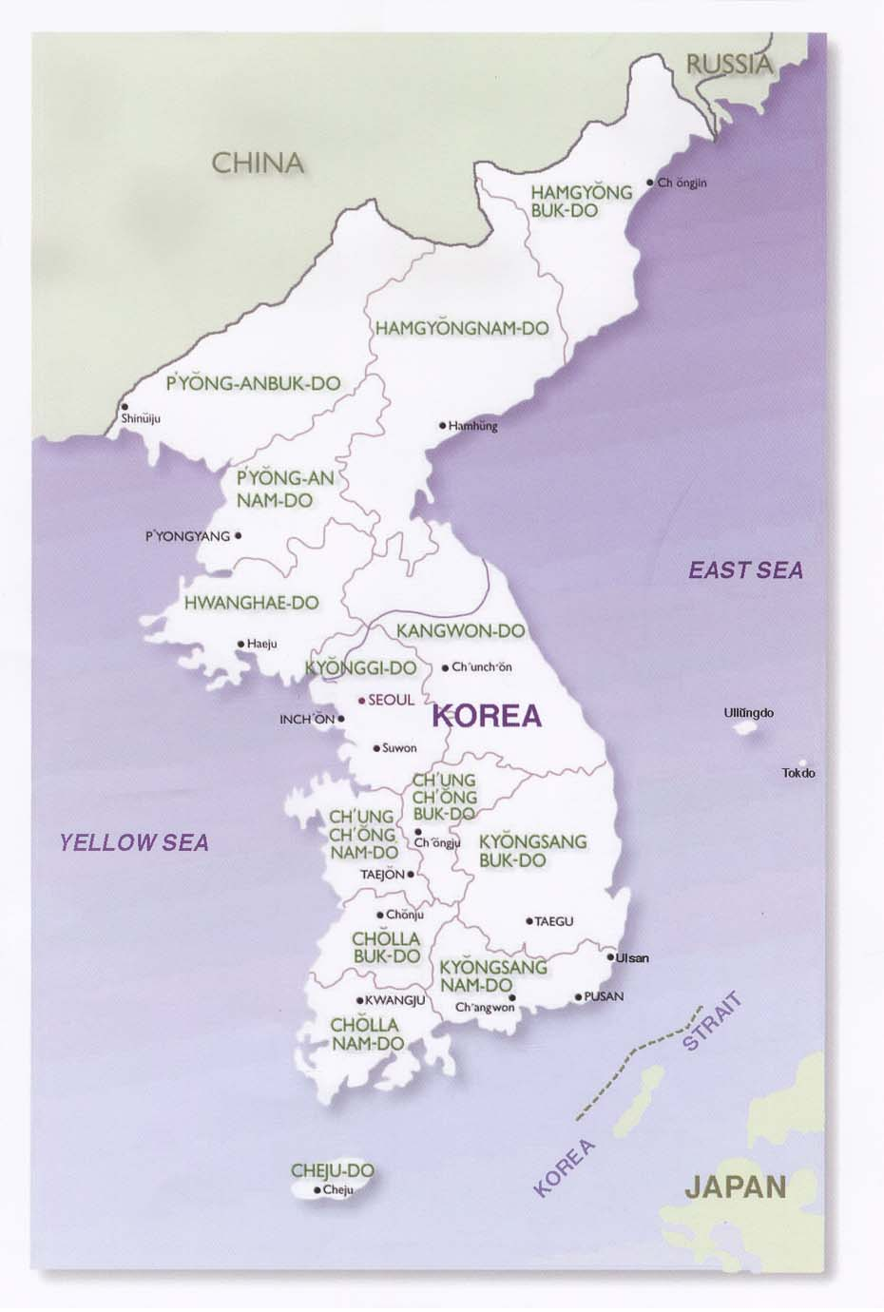

Slide 3
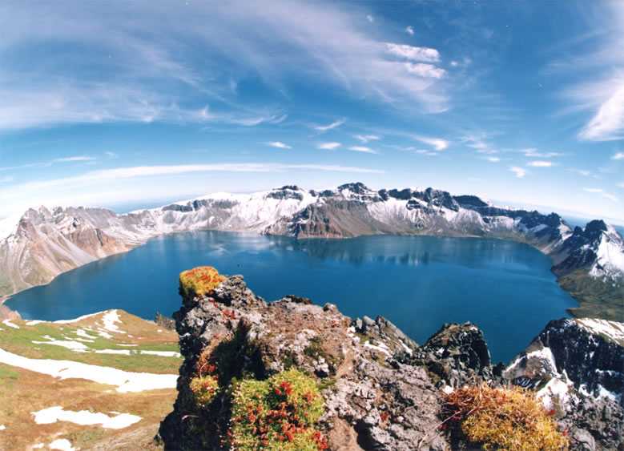
Physical Korea
Mountains dominate the country, with only 16% of land under cultivation even today.

Slide 4
Physical Korea
Development of agricultural came much later than it did in China, similar to Japan.
Mountains fragment country, as they fragment political activities as well. Political unification arrived late for the region.
South more fertile than North.

Slide 5
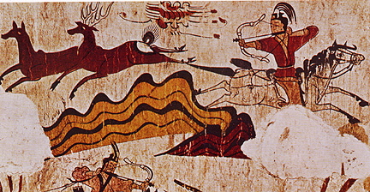
General Chronology
Ancient Chosŏn to Three Kingdoms Period (Antiquity to 668)
“Unified” Silla & Koryo (ca. 676- 1391)
Yi Korea (Chosŏn kingdom) (1392-1910)

Slide 6
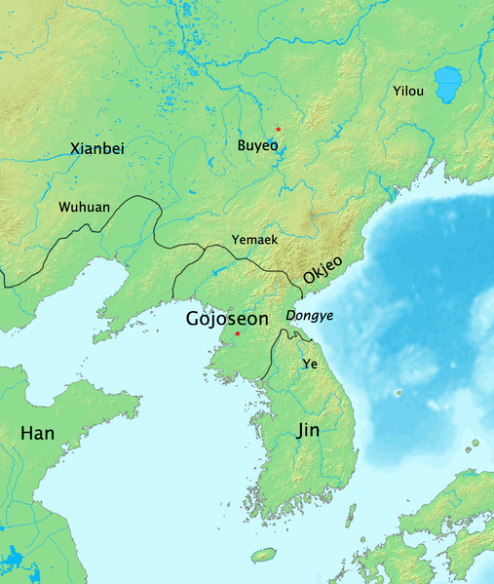
Ancient Chosŏn 朝鮮
Chosŏn developed from a league of tribes in the area of the Taedong and Liao rivers (c. 4th century BCE).

Slide 7
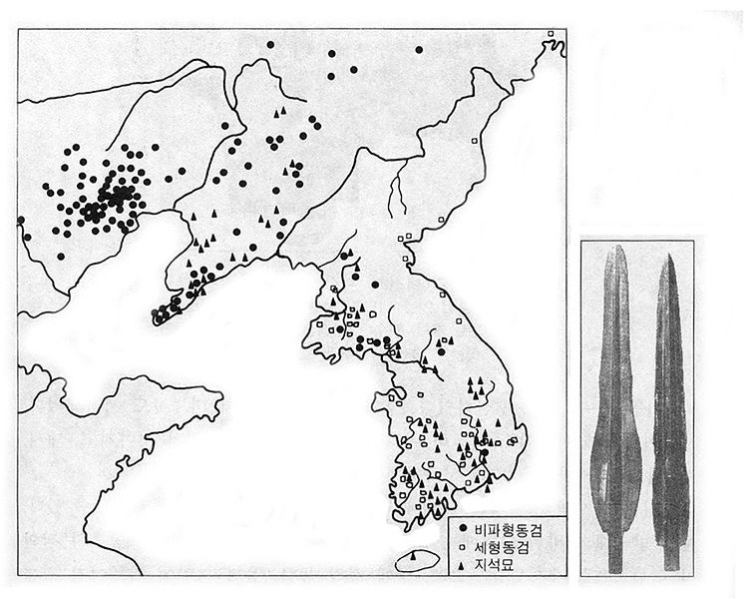
Han conquest of region in 108 BCE. Chosŏn was replaced by four Chinese colonies in 108 BCE. Chinese influence then declined with the fall of the Han Dynasty.

Slide 8
Wiman 衛滿
Ruler of Chosŏn in ca. 194 BCE. Wiman said to have defected from China. More likely, he was indigenous to Chosŏn.
Han conquest of Korea occurred in 108 BCE, but Chinese influence declined with the fall of the Han Dynasty.

